Slide 1


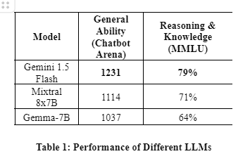
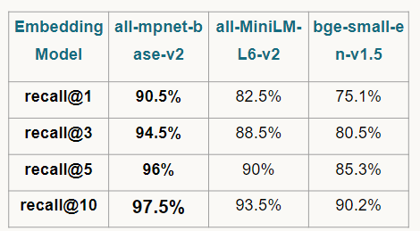
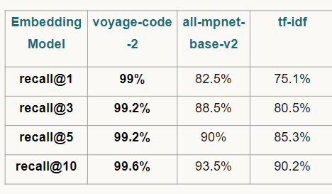
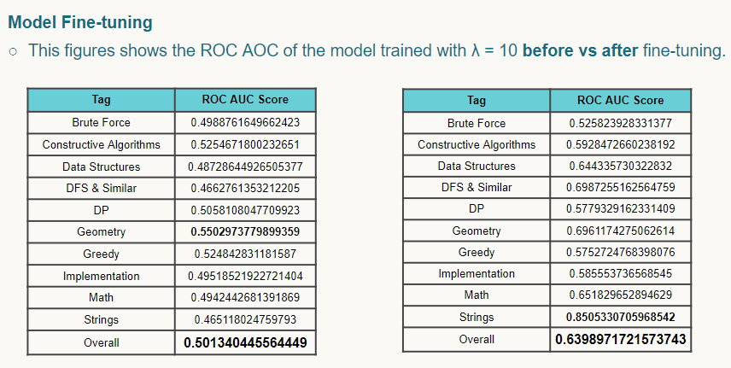
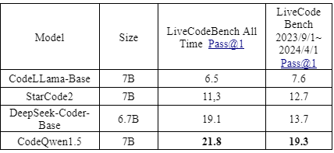
Intelligent Programming Companion (IPC)
Supervised by: Prof. Dr. Ahmed Salah, TA. Razan Bayoumi
Faculty of Computer and Information Sciences - Ain Shams University
Martina Al-Kes Angelos, Mohamed Hesham, Omar Yasser,
Salma Ayman, Salma Mahdy, Yosef Mahmoud
Introduction
Results
The field of Computer Science is characterized by its rapid evolution and the continuous learning demanded from students, professionals, and organizations alike. Within this dynamic landscape, problem-solving stands out as both a cornerstone of CS education and a crucial skill in competitive programming and interview preparation. Yet, despite its significance, several persistent challenges hinder its effective practice and application.
One of the foremost concerns revolves around the repetition and uniqueness of problems. Problem setters often inadvertently create similar challenges, granting unfair advantages to contestants familiar with these patterns and diminishing the value of problem sets.
Moreover, accurately assessing the difficulty of problems remains a recurring issue, impacting both the preparation process and the fairness of competitions.
Another significant challenge lies in the fragmentation of platforms. Currently, there lacks a centralized hub for problem setters to collaborate and share content, leading to confusion among contributors and difficulty for learners seeking consolidated resources.
Furthermore, the clarity of problem descriptions poses obstacles for both human solvers and AI-driven tools like GPT-3 and GitHub Copilot. Ambiguous problem statements hinder comprehension and effective solution development, exacerbating the learning curve for aspiring programmers.
Addressing these challenges promises to foster a more cohesive and supportive environment within the competitive programming community. By focusing on grouping problems, reducing repetition, refining descriptions, and establishing clearer difficulty criteria, we aim to empower learners and enhance the quality of preparation resources.
Our motivation stems from a commitment to advancing the field and supporting its participants. Through this research, we aspire to streamline the learning process, promote originality, and facilitate collaboration across the community. By harnessing cutting-edge technologies and addressing current gaps in problem sharing and assessment, we envision a future where competitive programming enthusiasts thrive, innovation flourishes among problem setters, and knowledge is shared seamlessly.
Problem Summarization
Module
Several low-cost or open-weight
LLMs were prompt-engineered
to summarize problem statements.
Table 1 summarizes the
performance of different
LLMs on these benchmarks.
2. Problem/Solution
Similarity Module
recall@k: Measure the hit rate of retrieving the gold standard document among top k retrieved documents.
- Problem Statements: A hit is when, for a summarized problem statement, the original problem is retrieved.
Solutions Source Codes: A hit is when, for a solution for a particular problem, there exists another solution for that same problem in the retrieved solutions. recall@k was measured for k = 1, 3, 5, 10.
Table 2: recall@k for problem statements Table 3: recall@k for solutions
3. Difficulty/Tags Prediction Module
Finetuning improved the model, as seen in the below table.
4. Solver Module
Different LLMs assessed on
LiveCodeBench.
CodeQwen was chosen
due to its state-of-the-art results.
Methods
We propose a systematic approach integrating four innovative modules into a centralized platform to tackle the challenges identified in the competitive programming and interview preparation domains. Each module addresses specific issues, leveraging advanced technologies and methodologies.
1. Problem Summarization Module
This module employs Google’s Gemini 1.5 LLM and prompt engineering to filter narratives, characters, legends, and contextual backgrounds from problem statements, distilling each problem's core essence. This enhances clarity, accessibility, and efficiency in problem-solving for competitive programming and interview preparation.
2. Problem/Solution Similarity Module
This module uses a nearest vector approach to represent each problem/solution as a vector in a high-dimensional space. By measuring distances between vectors, it identifies and flags similar problems/solutions, ensuring uniqueness and preserving the value of each problem.
3. Difficulty/Tags Prediction Module
This module employs a BigBird BERT-based architecture trained on labeled datasets to predict problem difficulty levels and relevant tags by extracting statement features, aiding users in problem selection and solving through accurate categorization and guidance.
4. Solver Module
The RAG architecture enhances LLMs’ capacity to offer precise, context-specific responses to unstructured data by integrating information retrieval and generative capabilities. This enables the solver module, utilizing RAG and Qwen LLM technologies, to operate as a chatbot that adapts dynamically to provide accurate responses across diverse questions and evolving data environments.
Conclusion
Significant challenges in competitive programming and interview preparation were addressed through the development of a centralized platform. The implemented modules. The Similarity Module achieved a remarkable 99.6% recall@10, and the Difficulty/Tags Prediction Module showed robust performance with a ROC AUC score of 76.37%. By addressing issues such as problem repetition, platform fragmentation, and ambiguous problem descriptions, our platform aims to create a more cohesive and supportive environment for competitive programmers and interview candidates.
Bibliography
Stoica, A., Băbiceanu, D., Rebedea, T., & Mihăescu, M.(2023). Unsupervised Voting for Detecting the Algorithmic Solving Strategy in Competitive Programming Solutions. Research Article https://doi.org/10.21203/rs.3.rs-2834777/v1
Athavale, V., Naik, A., Vanjape, R., & Shrivastava, M. (2019, April 4). Predicting algorithm classes for programming word problems. arXiv.org. https://doi.org/10.48550/arXiv.1903.00830
Crawshaw, M. (2020, September 10). Multi-task learning with deep neural networks: A survey. arXiv.org. https://doi.org/10.48550/arXiv.2009.0979

